Slide 1
COE 202: Digital Logic Design
Memory and Programmable Logic Devices

Slide 2
Objectives
Memory
Programmable Logic Devices (PLD)

Slide 3
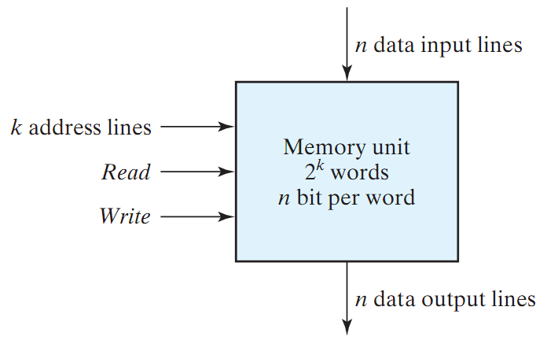
Memory
Memory: A collection of cells capable of storing binary information (1s or 0s) – in addition to electronic circuit for storing (writing) and retrieving (reading) information.
n data lines (input/output)
k address lines
2^{k} words (data unit)
Read/Write Control
Memory size = 2^{k} X n

Slide 4
Memory (cont.)
Two Types of Memory:
Random Access Memory (RAM):
  Write/Read operations
  Volatile: Data is lost when power is turned off
Read Only Memory (ROM):
  Read operation (no write)
  Non-Volatile: Data is permanent.
  PROM is programmable (allow special write)

Slide 5
Programmable Logic Devices
Programmable Logic Device (PLD) is an integrated circuit with internal logic gates and/or connections that can in some way be changed by a programming process
  Examples:
    PROM
    Programmable Logic Array (PLA)
    Programmable Array Logic (PAL) device
    Complex Programmable Logic Device (CPLD)
    Field-Programmable Gate Array (FPGA)
A PLD’s function is not fixed
  Can be programmed to perform different functions

Slide 6
Why PLDS?
Fact:
  It is most economical to produce an IC in large volumes
But:
  Many situations require only small volumes of ICs
  Many situations require changes to be done in the field, e.g. Firmware of a product under development
A programmable logic device can be:
  Produced in large volumes
  Programmed to implement many different low-volume designs

Slide 7
PLD Hardware Programming Technologies
In the Factory - Cannot be erased/reprogrammed by user
  Mask programming (changing the VLSI mask) during manufacturing
Programmable only once
  Fuse
  Anti-fuse
Reprogrammable (Erased & Programmed many times)
  Volatile - Programming lost if chip power lost
    Single-bit storage element
  Non-Volatile - Programming survives power loss
    UV Erasable
    Electrically Erasable
      Flash (as in Flash Memory)

Slide 8
Used symbol in PLD
Multi-input OR gate
There is a connection
There is no connection
conventional symbol
array logic symbol
Most PLD technologies have gates with very high fan-in
Fuse map: graphic representation of the selected connections

Slide 9
Programmable Logic Devices (PLDs)
All use AND-OR structure- differ in which is programmable
Fixed
AND array
(decoder)
Programmable
connections
Programmable
OR array
Inputs
Outputs
Programmable read-only memory (PROM)
Programmable
connections
Programmable
AND array
Fixed
OR array
Inputs
Outputs
Programmable array logic (PAL) device
Programmable
connections
Programmable
AND array
Programmable
connections
Programmable
OR array
Inputs
Outputs
Programmable logic array (PLA)

Slide 10
Read-Only Memory (ROM)
ROM: A device in which “permanent” binary information is stored using a special device (programmer)
k inputs (address) → 2^{k} words each of size n bits (data)
ROM DOES NOT have a write operation ➔ ROM DOES NOT have data inputs
k inputs
(address)
2^{k} x n ROM
n outputs
(data)
Word: group of bits stored in one location

Slide 11
ROM Internal Logic
The decoder stage produces ALL possible minterms
32 Words of 8 bits each
5 input lines (address)
Each OR gate has a 32 input
A contact can be made using fuse/anti-fuse
Internal Logic of a 32x8 ROM
I₀
I₁
I₂
I₃
I₄
0
1
2
3
.
.
.
28
29
30
31
5-to-32
decoder
A7 A6 A5 A4 A3 A2 A1 A0

Slide 12
Programming a ROM
Inputs |  |  |  |  |  | Outputs
I4 | I3 | I2 | I1 | I0 |  | A7 | A6 | A5 | A4 | A3 | A2 | A1 | A0
0 | 0 | 0 | 0 | 0 |  | 1 | 0 | 1 | 1 | 0 | 1 | 1 | 0
0 | 0 | 0 | 0 | 1 |  | 0 | 0 | 0 | 1 | 1 | 1 | 0 | 1
0 | 0 | 0 | 1 | 0 |  | 1 | 1 | 0 | 0 | 0 | 1 | 0 | 1
0 | 0 | 0 | 1 | 1 |  | 1 | 0 | 1 | 1 | 0 | 0 | 1 | 0
 |  | . |  |  |  |  |  |  | .
 |  | . |  |  |  |  |  |  | .
 |  | . |  |  |  |  |  |  | .
1 | 1 | 1 | 0 | 0 |  | 0 | 0 | 0 | 0 | 1 | 0 | 0 | 1
1 | 1 | 1 | 0 | 1 |  | 1 | 1 | 1 | 0 | 0 | 0 | 1 | 0
1 | 1 | 1 | 1 | 0 |  | 0 | 1 | 0 | 0 | 1 | 0 | 1 | 0
1 | 1 | 1 | 1 | 1 |  | 0 | 0 | 1 | 1 | 0 | 0 | 1 | 1
0
1
2
3
.
.
.
28
29
30
31
x
x
x
x
x
I₀
I₁
I₂
I₃
I₄
x
x
x
x
x
x
x
x
x
x
x
x
5-to-32
decoder
x
x
x
x
x
x
x
x
x
x
x
x
x
A7 A6 A5 A4 A3 A2 A1 A0
Every ONE in truth table specifies a closed circuit
Every ZERO in truth table specifies an OPEN circuit
Example: At address 00011 → The word 10110010 is stored

Slide 13
Combinational Circuit Implementation with ROM
ROM = Decoder + OR gates
Implementation of a combinational circuit is easy
  Store the truth table by programming the ROM
Only need to provide the truth table

Slide 14
Example 1
Example: Design a combinational circuit using ROM. The circuit accepts a 3-bit number and generates an output binary number equal to the square of the number.
Solution: Derive truth table:
Inputs |  |  |  | Outputs
A2 | A1 | A0 |  | B5 | B4 | B3 | B2 | B1 | B0 | SQ
0 | 0 | 0 |  | 0 | 0 | 0 | 0 | 0 | 0 | 0
0 | 0 | 1 |  | 0 | 0 | 0 | 0 | 0 | 1 | 1
0 | 1 | 0 |  | 0 | 0 | 0 | 1 | 0 | 0 | 4
0 | 1 | 1 |  | 0 | 0 | 1 | 0 | 0 | 1 | 9
1 | 0 | 0 |  | 0 | 1 | 0 | 0 | 0 | 0 | 16
1 | 0 | 1 |  | 0 | 1 | 1 | 0 | 0 | 1 | 25
1 | 1 | 0 |  | 1 | 0 | 0 | 1 | 0 | 0 | 36
1 | 1 | 1 |  | 1 | 1 | 0 | 0 | 0 | 1 | 49

Slide 15
Example 1 (cont.)
Inputs |  |  |  | Outputs
A2 | A1 | A0 |  | B5 | B4 | B3 | B2 | B1 | B0 | SQ
0 | 0 | 0 |  | 0 | 0 | 0 | 0 | 0 | 0 | 0
0 | 0 | 1 |  | 0 | 0 | 0 | 0 | 0 | 1 | 1
0 | 1 | 0 |  | 0 | 0 | 0 | 1 | 0 | 0 | 4
0 | 1 | 1 |  | 0 | 0 | 1 | 0 | 0 | 1 | 9
1 | 0 | 0 |  | 0 | 1 | 0 | 0 | 0 | 0 | 16
1 | 0 | 1 |  | 0 | 1 | 1 | 0 | 0 | 1 | 25
1 | 1 | 0 |  | 1 | 0 | 0 | 1 | 0 | 0 | 36
1 | 1 | 1 |  | 1 | 1 | 0 | 0 | 0 | 1 | 49
B₀
ROM truth table – specifies the required connections
0
B₁
A₀
8 X 4 ROM
B₂
B1 is ALWAYS 0 ➔ no need to generate it using the ROM
B0 is equal to A0 ➔ no need to generate it using the ROM
Therefore: The minimum size of ROM needed is 2³X4 or 8X4
A₁
B₃
B₄
A₂
B₅

Slide 16
Example 2
Problem: Tabulate the truth for an 8 X 4 ROM that implements the following four Boolean functions:
A(X,Y,Z) = Σm(3,6,7); B(X,Y,Z) = Σm(0,1,4,5,6)
C(X,Y,Z) = Σm(2,3,4); D(X,Y,Z) = Σm(2,3,4,7)
Solution:
8 X 4 ROM
A
X
B
Y
Z
C
D
Inputs |  |  |  | Outputs
X | Y | Z |  | A | B | C | D
0 | 0 | 0 |  | 0 | 1 | 0 | 0
0 | 0 | 1 |  | 0 | 1 | 0 | 0
0 | 1 | 0 |  | 0 | 0 | 1 | 1
0 | 1 | 1 |  | 1 | 0 | 1 | 1
1 | 0 | 0 |  | 0 | 1 | 1 | 1
1 | 0 | 1 |  | 0 | 1 | 0 | 0
1 | 1 | 0 |  | 1 | 1 | 0 | 0
1 | 1 | 1 |  | 1 | 0 | 0 | 1

Slide 17
Example 3 (Size of a ROM)
Problem: Specify the size of a ROM (number of words and number of bits per word) that will accommodate the truth table for the following combinational circuit: An 8-bit adder/subtractor with Cin and Cout.
Solution:
Inputs to the ROM (address lines) = 8 (first number) + (8 second number) + 1 (Cin) + 1 (Add/Subtract) ➔ 18 lines
Hence number of words in ROM is 218 = 256K
Size of each word = number of possible functions/outputs
= 16 (addition/subtraction) + 1 (Cout)
= 17
Hence ROM size = 256K X 17

Slide 18
Sequential Circuit Implementation with ROM
Combinational
Circuits
inputs X
outputs Z
present state
next state
FFs
sequential circuit = combinational circuit + memory
Combinational part can be built with a ROM as shown previously
  Number of address lines = No. of FF + No. of inputs
  Number of outputs = No. of FF + No. of outputs

Slide 19
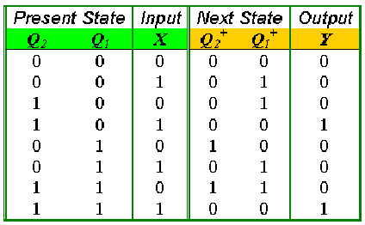
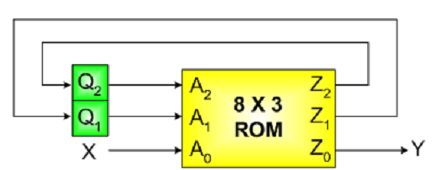
Example
Example: Design a sequential circuit whose state table is given, using a ROM and a register.
State Table
We need a 8x3 ROM (why?)
3 address lines and 3 data lines
Exercise: Compare design with ROMs with the traditional design procedure.

Slide 20
Types of ROMs
A ROM programmed in four different ways:
ROM: Mask Programming
  By a semiconductor company
PROM (Programmable ROM)
  User can blow/connect fuses with a special programming device (PROM programmer)
  Only programmed once!
EPROM (Erasable PROM)
  Can be erased using Ultraviolet Light
Electrically Erasable PROM (EEPROM or E²PROM)
  Like an EPROM, but erased with electrical signal

Slide 21
Other PLDs
All use AND-OR structure- differ in which is programmable
Fixed
AND array
(decoder)
Programmable
connections
Programmable
OR array
Inputs
Outputs
Programmable read-only memory (PROM)
Programmable
connections
Programmable
AND array
Fixed
OR array
Inputs
Outputs
Programmable array logic (PAL) device
Programmable
connections
Programmable
AND array
Programmable
connections
Programmable
OR array
Inputs
Outputs
Programmable logic array (PLA)

Slide 22
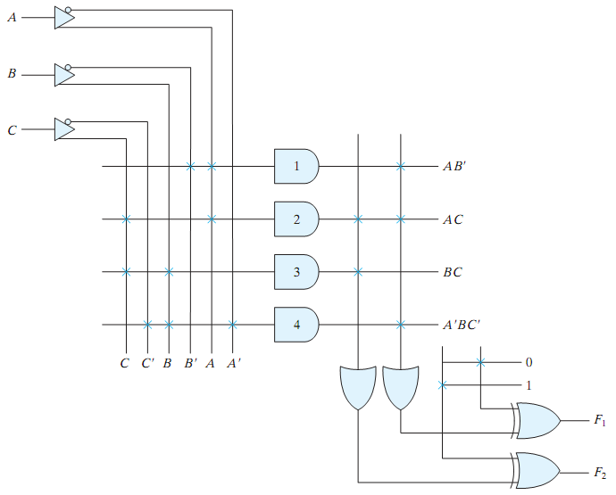
Programmable Logic Array (PLA)
AND array and OR array are programmable
XOR is available to complement an output if needed
Example:
  3 inputs/2 outputs
  F₁ = A B’ + A C + A’ B C’
  F2 = (AC + BC)’
Source: Mano’s textbook

Slide 23
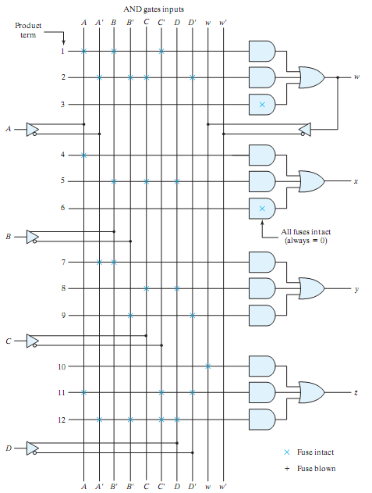
Programmable Array Logic (PAL)
Fixed OR array and programmable AND array
  Opposite of ROM
Feed back is used to support more product terms
AND output can not be shared here!
Example:
4 inputs/4 outputs with fixed 3-input OR gates
W = A B C’ + A’ B’ C D’
X = ?
Y = ?
Z = ?
Source: Mano’s textbook

Slide 24
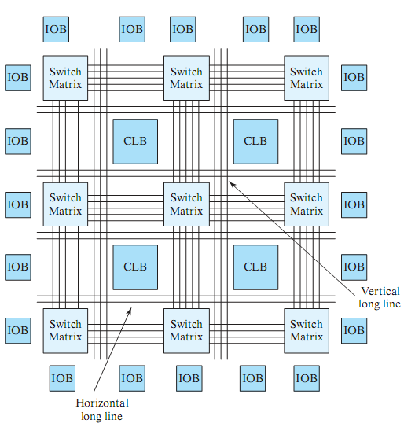
Field Programmable Gate Array (FPGA)
Xilinx FPGAs
Configurable Logic Block (CLB)
  Programmable logic and FFs
Programmable Interconnects
  Switch Matrices
  Horizontal/vertical lines
I/O Block (IOB)
  Programmable I/O pins
Source: Mano’s textbook

Slide 25
More on PLDs
Read Section 6.8 in the textbook
Wikipedia/Youtube

